Slide 1

CSE223: Data Structures and Algorithms using C
Dr. Murali Krishna Enduri
Department of CSE

Slide 2
Syllabus
SUBJECT CODE | SUBJECT TITLE | CORE/ ELECTIVE | CREDITS
 |  |  | L | T | P | C
CSE 223 | Data Structures and Algorithms using C | C | 3 | 0 | 2 | 4
Unit I
Introduction to C programming, identifiers, basic data types, constants, variables, keywords, Operators: arithmetic, relational and logical, increment and decrement operators, conditional operator, assignment operators, Instruction: type declaration, Input-output, conditional, loop control, Arrays, Functions, pointers, dynamic memory management functions
Derived types- structures- declaration, definition and initialization of structures, accessing member of structure, arrays of structures, structures and functions, pointers to structures, self referential structures

Slide 3
Syllabus
Unit II
Introduction to data structures: Stacks and Queues: representation and application, Implementation of stack and queue operations using C.
Linked lists: Single linked lists, implementation of link list and various operation using C, Double linked list, circular list.
Unit III
Trees: Tree terminology, Binary tree, Binary search tree, infix to post fix conversion, postfix expression evaluation. General tree, AVL Tree, Complete Binary Tree representation
Unit IV
Graphs: Graph terminology, Representation of graphs, Path matrix, BFS (breadth first search), DFS (depth first search), topological sorting, Shortest path algorithms

Slide 4
Syllabus
Unit V
Sorting and Searching techniques – Bubble sort, selection sort, Insertion sort, Quick sort, merge sort, Heap sort, Radix sort, implementation using C.
Linear and binary search methods, implementation using C, Hashing techniques and hash functions.

Slide 5
Books of Study and References
Books of Study
“Data structure using C”, Aaron M. Tenenbaum, Y Langsam and Mosche J. Augenstein, Pearson publication.
Data structures and Algorithm Analysis in C , Mark Allen Weiss, Pearson publications, Second Edition
Programming in C. P. Dey and M Ghosh , Second Edition, Oxford University Press.
Programming with C, Byron Gottfried, Mcgrawhill Education, Fourteenth reprint, 2016
Books of References
“Fundamentals of data structure in C” Horowitz, Sahani & Anderson Freed, Computer Science Press.
“Fundamental of Data Structures” , (Schaums Series) Tata-McGraw-Hill.
G. A. V. Pai: “Data Structures & Algorithms; Concepts, Techniques & Algorithms”Tata McGraw Hill.
Gilberg and Forouzan, “Data Structure- A Pseudo code approach with C” by Thomson publication

Slide 6
Distribution of Marks
Internal
 | Assessment tool | Conducting Marks | Converting Marks | Final Conversion
Theory | Mid-term-I | 25 | 15 | 30
 | Mid-term-II | 25 | 15
 | Assignments | 10 | 10
 | Quiz | 10 | 10
Practical | Lab performance | 20 | 20 | 20
 | Observation note | 10 | 10
 |  |  | Total | 50
External
 | Assessment tool | Conducting Marks | Final Conversion
End semester theory exam | Final exam | 100 | 30
End semester Practical exam | Final Lab exam | 100 | 20
 | Observation note
 |  | Total | 50

Slide 7

Introduction to C Programming

Slide 8
C: History
The C programming language was designed by Dennis Ritchie at Bell Laboratories in the early 1970s
Influenced by
ALGOL 60 (1960),
CPL (Cambridge, 1963),
BCPL (Martin Richard, 1967),
B (Ken Thompson, 1970)
Traditionally used for systems programming, though this may be changing in favor of C++
Traditional C:
The C Programming Language, by Brian Kernighan and Dennis Ritchie, 2nd Edition, Prentice Hall
Referred to as K&R

Slide 9
C: History
Standardized in 1989 by ANSI (American National Standards Institute) known as ANSI C
International standard (ISO) in 1990 which was adopted by ANSI and is known as C89
As part of the normal evolution process the standard was updated in 1995 (C95) and 1999 (C99)
C++ and C
C++ extends C to include support for Object Oriented Programming and other features that facilitate large software development projects
C is not strictly a subset of C++, but it is possible to write “Clean C” that conforms to both the C++ and C standards.

Slide 10
C: Application
Developed in the 1970s – in conjunction with development of UNIX operating system
When writing an OS kernel, efficiency is crucial
This requires low-level access to the underlying hardware:
e.g. programmer can leverage knowledge of how data is laid out in memory, to enable faster data access
UNIX originally written in low-level assembly language – but there were problems:
No structured programming (e.g. encapsulating routines as “functions”, “methods”, etc.) – code hard to maintain
Code worked only for particular hardware – not portable

Slide 11
C: Characteristics
C takes a middle path between low-level assembly language…
Direct access to memory layout through pointer manipulation
Concise syntax, small set of keywords
… and a high-level programming language like Java:
Block structure
Some encapsulation of code, via functions
Type checking (pretty weak)

Slide 12
C: Compilation
A C program consists of source code in one or more files
Each source file is run through the preprocessor and compiler, resulting in a file containing object code
Object files are tied together by the linker to form a single executable program
Compilers: Microsoft Visual C++, GCC, Borland C
Source code
file1.c
Preprocessor/
Compiler
Object code
file1.o
Source code
file2.c
Preprocessor/
Compiler
Object code
file2.o
Libraries
Linker
Executable code
a.out

Slide 13
A Simple C Program
Create example file: test.c
Compile using gcc: gcc –o testout test.c
The standard C library libc is included automatically
Execute program ./testout
Note, I always specify an absolute path
Normal termination: void exit(int status);
calls functions registered with atexit()
flush output streams
close all open streams
return status value and control to host environment
/* you generally want to
* include stdio.h and
*/
#include <stdio.h>
int main()
{
printf(“Hello World\n”);
return 0;
}

Slide 14
In Sample Program
Comments
Text surrounded by /* and */ is ignored by computer
Used to describe program
#include <stdio.h>
Preprocessor directive
Tells computer to load contents of a certain file
<stdio.h> allows standard input/output operations
/* you generally want to
* include stdio.h and
*/
#include <stdio.h>
int main()
{
printf(“Hello World\n”);
return 0;
}
int main()
C++ programs contain one or more functions, exactly one of which must be main
Parenthesis used to indicate a function
int means that main "returns" an integer value
Braces ({ and }) indicate a block
The bodies of all functions must be contained in braces

Slide 15
In Sample Program
printf( "Hello World\n" );
Instructs computer to perform an action
Specifically, prints the string of characters within quotes (“ ”)
Entire line called a statement
All statements must end with a semicolon (;)
Escape character (\)
Indicates that printf should do something out of the ordinary
\n is the newline character
/* you generally want to
* include stdio.h and
* */
#include <stdio.h>
int main()
{
printf(“Hello World\n”);
return 0;
}
return 0;
A way to exit a function
return 0, in this case, means that the program terminated normally
Right brace }
Indicates end of main has been reached

Slide 16
Basic Data Types
The most common types are: char, int, float, and double.
Strings are arrays of characters (we’ll cover arrays later).
Declare a variable before you use it:
int x; /* declares an integer called x. Its value is not assigned. */
float y, z = 3.14159; /* declares two floating point numbers. z is set equal to pi */
z = 4; /* now z is equal to 4 */
myVal = 2; /* This would be an error, because myVal was not yet declared */

Slide 17
Basic Data Types
Integral Types
Integers are stored in various sizes. They can be signed or unsigned.
Example Suppose an integer is represented by a byte (8 bits). Leftmost bit is sign bit. If the sign bit is 0, the number is treated as positive. Bit pattern 01001011 = 75 (decimal). The largest positive number is 01111111 = 2⁷ – 1 = 127.

Slide 18
Basic Data Types
Integral Types
char Stored as 8 bits. Unsigned 0 to 255. Signed -128 to 127.
short int Stored as 16 bits. Unsigned 0 to 65535. Signed -32768 to 32767.
int Same as either short or long int.
long int Stored as 32 bits. Unsigned 0 to 4294967295. Signed -2147483648 to 2147483647

Slide 19
Basic Data Types
Floating Point Numbers
Floating point numbers are rational numbers. Always signed numbers.
float Approximate precision of 6 decimal digits .
Typically stored in 4 bytes with 24 bits of signed mantissa and 8 bits of signed exponent.
double Approximate precision of 14 decimal digits.
Typically stored in 8 bytes with 56 bits of signed mantissa and 8 bits of signed exponent.

Slide 20
Basic Data Types
Questions:
Numbers with a decimal point (12.34) are stored as ??
Integers like 12, 253 are stored as ?? Data type
Program A
Program B
#include <stdio.h>
int main()
{
float c = 5.0;
printf ("Temperature in Fahrenheit is %.2f", (9/5)*c + 32);
return 0;
}
#include<stdio.h>
int main()
{
int c = 125;
c = c+10;
printf("%d", c);
return 0;
}
Output ??
Output ??

Slide 21
Variables
Naming a Variable
Must be a valid identifier.
Must not be a keyword
Names are case sensitive.
Variables are identified by only first 32 characters.
Library commonly uses names beginning with _.
Naming Styles: Uppercase style and Underscore style
Examples:
lowerLimit lower_limit
incomeTax income_tax

Slide 22
Variable Declarations
Declaring a Variable
Each variable used must be declared.
A form of a declaration statement is
data-type var1, var2,…;
Declaration announces the data type of a variable and allocates appropriate memory location. No initial value (like 0 for integers) should be assumed.
It is possible to assign an initial value to a variable in the declaration itself.
data-type var = expression;
Examples
int sum = 0;
char newLine = ‘\n’;
float epsilon = 1.0e-6;

Slide 23
Operators
Arithmetic Operators
+, - , *, / and the modulus operator %.
+ and – have the same precedence and associate left to right.
3 – 5 + 7 = ( 3 – 5 ) + 7 ≠ 3 – ( 5 + 7 )
3 + 7 – 5 + 2 = ( ( 3 + 7 ) – 5 ) + 2
*, /, % have the same precedence and associate left to right.
The +, - group has lower precendence than the *, / % group.
3 – 5 * 7 / 8 + 6 / 2
3 – 35 / 8 + 6 / 2
3 – 4.375 + 6 / 2
3 – 4.375 + 3
-1.375 + 3
1.625

Slide 24
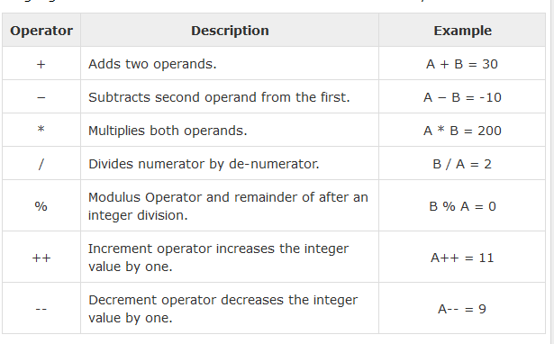
Operators
Assume variable A holds 10 and variable B holds 20

Slide 25
#include <stdio.h>
void main() {
int a = 21,b=10, c ;
c = a + b;
printf("Line 1 - Value of c is %d\n", c );
c = a - b;
printf("Line 2 - Value of c is %d\n", c );
c = a * b;
printf("Line 3 - Value of c is %d\n", c );
c = a / b;
printf("Line 4 - Value of c is %d\n", c );
c = a % b;
printf("Line 5 - Value of c is %d\n", c );
c = a++;
printf("Line 6 - Value of c is %d\n", c );
c = a--;
printf("Line 7 - Value of c is %d\n", c );
}
Output ??

Slide 26
Operators
Arithmetic Operators
% is a modulus operator. x % y results in the remainder when x is divided by y and is zero when x is divisible by y.
Cannot be applied to float or double variables.
Example
if ( num % 2 == 0 )
printf(“%d is an even number\n”, num)’;
else
printf(“%d is an odd number\n”, num);

Slide 27
Type Conversions
The operands of a binary operator must have a the same type and the result is also of the same type.
Integer division:
c = (9 / 5)*(f - 32)
The operands of the division are both int and hence the result also would be int. For correct results, one may write
c = (9.0 / 5.0)*(f - 32)
In case the two operands of a binary operator are different, but compatible, then they are converted to the same type by the compiler. The mechanism (set of rules) is called Automatic Type Casting.
c = (9.0 / 5)*(f - 32)
It is possible to force a conversion of an operand. This is called Explicit Type casting.
c = ((float) 9 / 5)*(f - 32)

Slide 28
Automatic Type Conversions
char and short operands are converted to int
Lower data types are converted to the higher data types and result is of higher type.
The conversions between unsigned and signed types may not yield intuitive results.
Example
float f; double d; long l;
int i; short s;
d + f f will be converted to double
i / s s will be converted to int
l / i i is converted to long; long result
Hierarchy
double
float
long
int
short and char

Slide 29
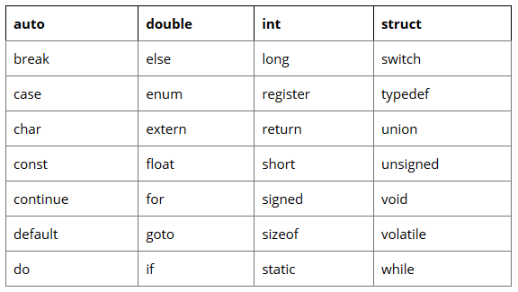
Keywords
Keywords are those words whose meaning is already defined by Compiler
Cannot be used as Variable Name
There are 32 Keywords in C

Slide 30
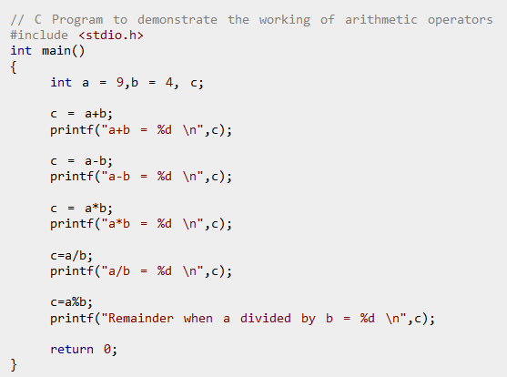
Output ??

Slide 31
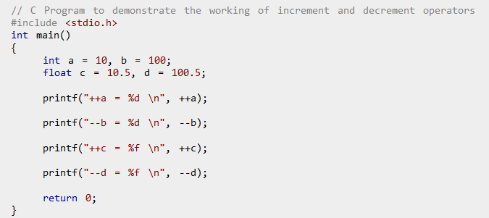
Output ??

Slide 32
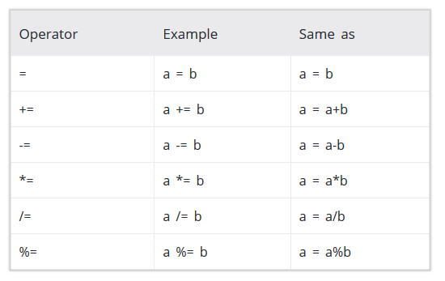

Slide 33
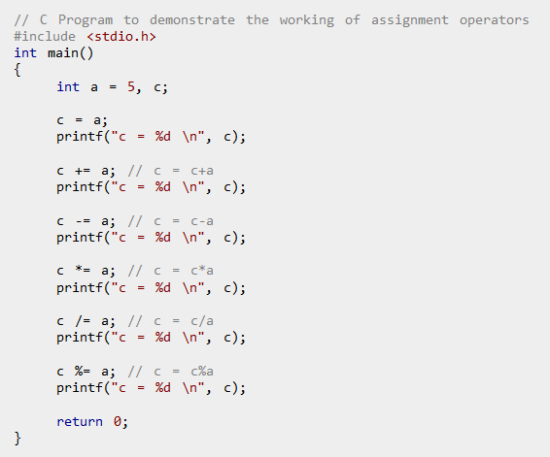
Output ??

Slide 34
// C program to demonstrate working of Unary arithmetic operators
#include <stdio.h>
void main() {
{
int a = 10, b = 4, res;
res = a++;
printf("a is %d and res is %d\n", a, res);
res = a--;
printf("a is %d and res is %d\n", a, res);
res = ++a;
printf("a is %d and res is %d\n", a, res);
res = --a;
printf("a is %d and res is %d\n",a,res);
return 0;
}
Output ??

